Slide 1

Report Summary on Infosys Technology Budgets
Sampath Raj P
+91-8522979135
samraj0710@gmail.com

Slide 2
Business Case
A Survey data of different business taken with how different technology budgets were allocated across 4 different technologies and how they expect their budgets to change.
Recent annual fiscal revenue
Recent quarterly fiscal revenue
Quarterly fiscal revenue change year-over-year
Data Input

Slide 3
Agenda
Data Preprocessing
Exploratory Data Analysis
Summary Reports
Insights

Slide 4
Data Preprocessing
Data preprocessing involves preparing, cleaning, and shaping raw data into a suitable format for analysis and visualization.
Given raw data is the unprocessed and unorganized data collected directly from a survey source.
It is the initial form of data before any processing and analysis.
Raw data is typically messy, and unstructured, and may contain errors, inconsistencies, or missing values.
From Survey Data, Responses are collected from a survey therefore they are cleaned and categorized before summarizing business reports
To start preprocessing a dataset:
Sample Survey data is considered,
I have used Power BI and load the data set,
in the Home tab, Used Transform data option to open the Power Query Editor.

Slide 5
Exploratory Data Analysis- EDA Phase
Assumption
Assume that ‘No allocation’ from all the 4 Technologies for current quarter change (%) as Zéro, as there is no Allocation from the technologies for the last Quarter provided.
To facilitate comparisons across technologies, unpivot the budget allocation and budget change columns for Technology A, B, C, and D.
Created custom columns using DAX for easy understanding of the Attribute columns data.
Comparition of Annual Incomes with Quarterly Revenue is not a better justification in any data analysis carried for the Survey
Data Understanding
Checked Data Types based on the Source data
Observed No Missing Values
Also noticed there are Some Outliers in the data

Slide 6
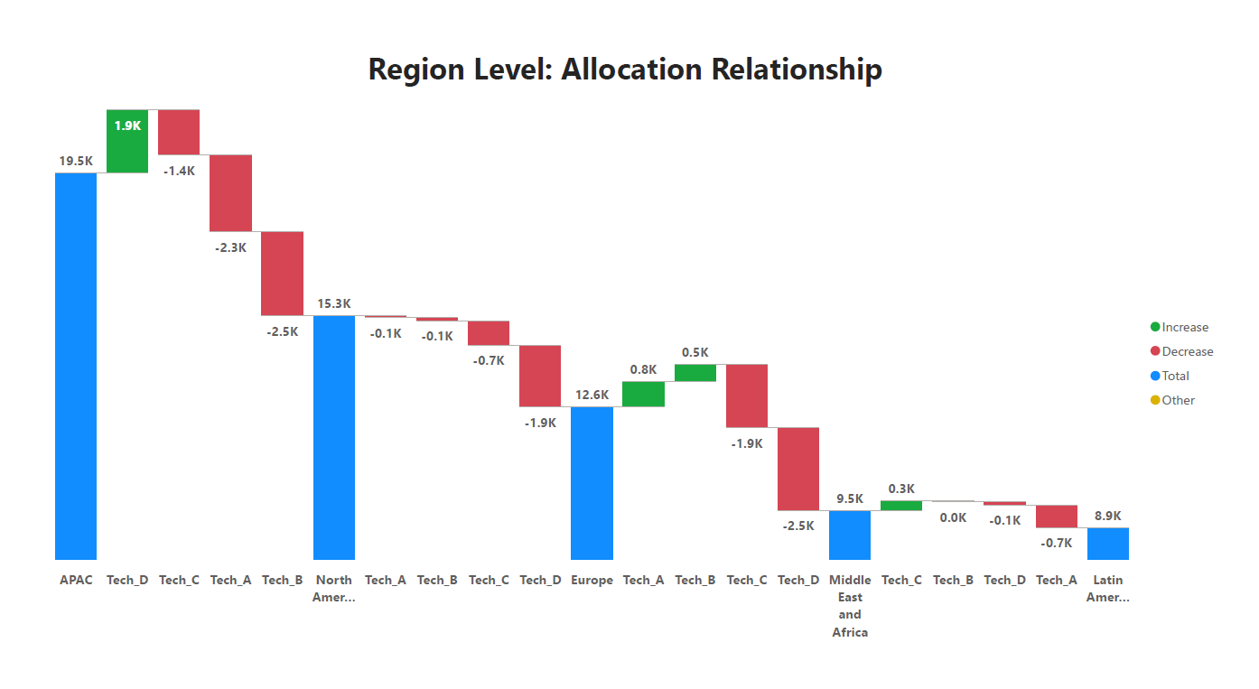
Summary Reports
Q1. What is the relationship between region and budget allocation for each technology?
There are five regions in business and APAC is highest technology allocation and lowest region is Latin America
Tech-D is contributed positively to APAC region
Tech-A and Tech-B is contributed positively to Europe region
Tech-C is contributed positively to Middle East Asia
But, for North America region all allocations are under budget

Slide 7
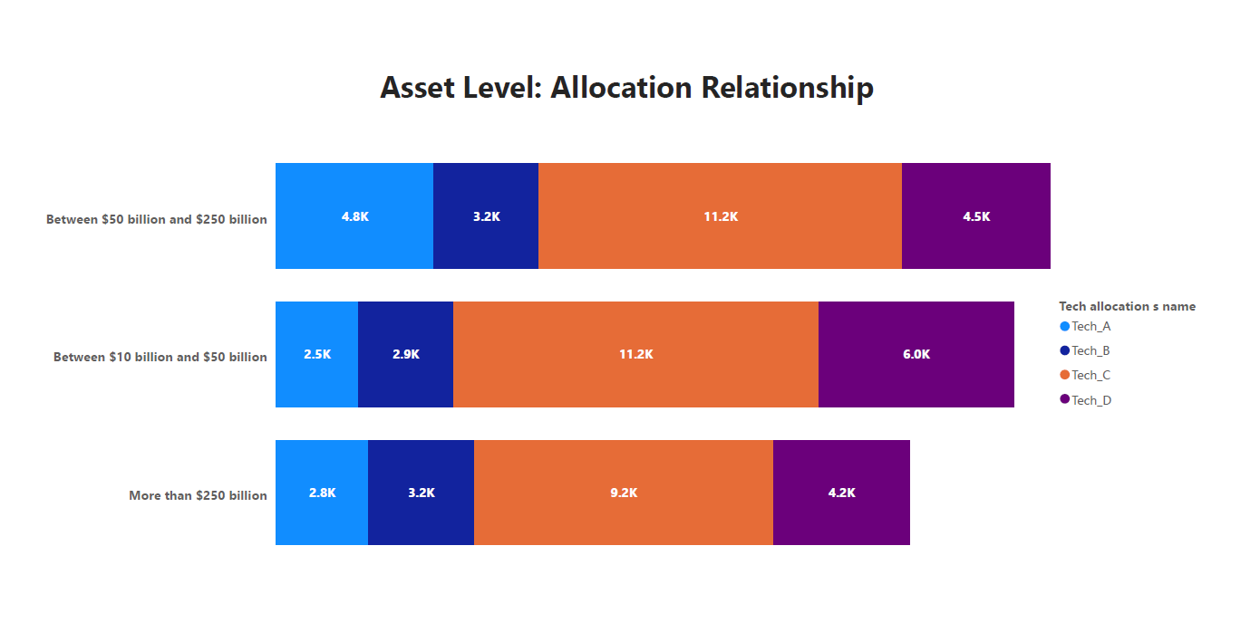
Summary Reports
Q2. What is the relationship between total assets and budget allocation for each technology?
Out of all 3 assets ‘Between $50 billion and $250 billion’ is highest asset Allocation and More than $250 billion have the lowest
Tech – A in ‘Between $50 billion and $250 billion’ observed having double its contribution when compared to other 2 assets.
Tech – C in all the asset have the highest allocation budget and Tech– B have the lowest.

Slide 8
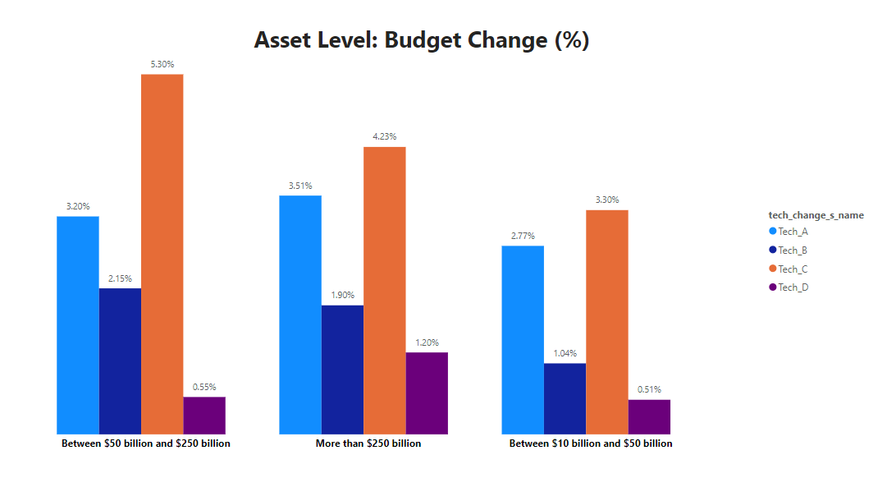
Summary Reports
Q3. What is the relationship between total assets and the budget change for each technology?
Tech – C have the highest budget change at Asset Level and Tech – D have the lowest.
Tech – C have the highest budget change in Between $50 billion and $250 billion have 5.30% high.
Tech – D in asset Between $10 billion and $50 billion have the lowest contribution change of 0.51%

Slide 9
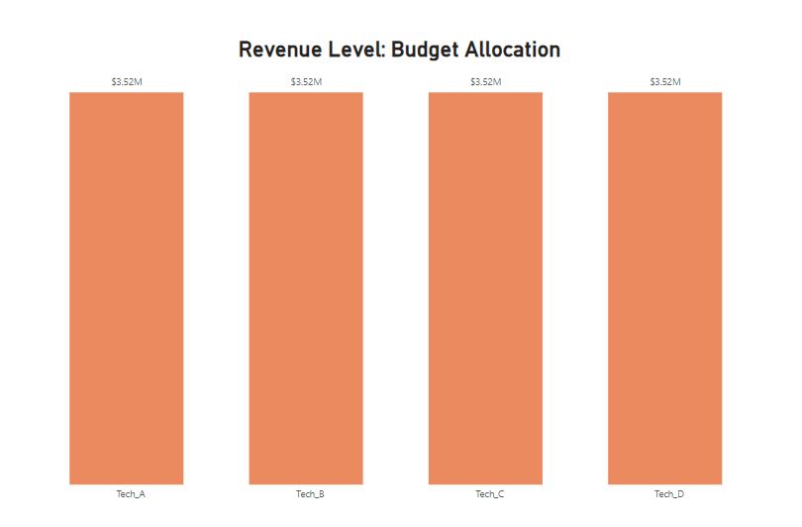
Summary Reports
Q4. What is the relationship between revenue and budget allocation for each technology?
All the Technologies revenue is equally distributed
All the Technologies have the same revenue allocation of $3.52M

Slide 10
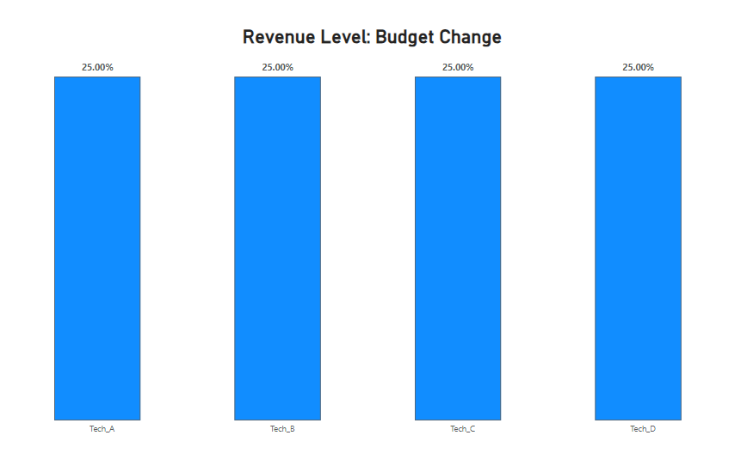
Summary Reports
Q5. What is the relationship between revenue and budget change for each technology?
All the Technologies Budget change equally distributed
All the Technologies have the same revenue change of 25%

Slide 11
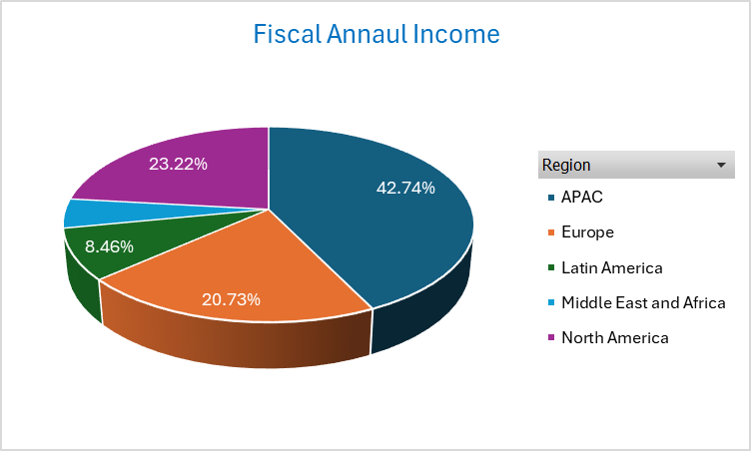
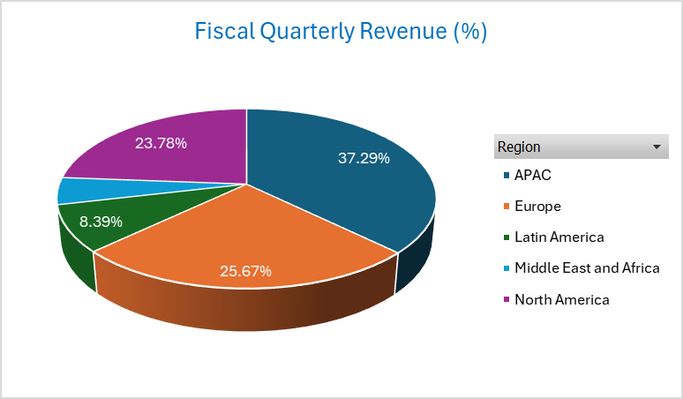
Summary Statistics: Region Wise Annual Income & Quarterly Revenue

Slide 12
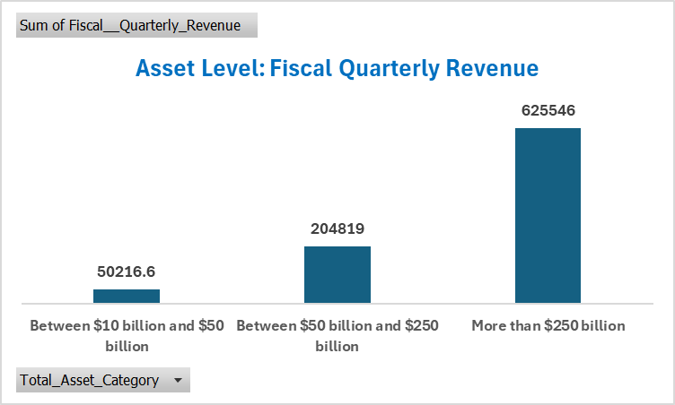
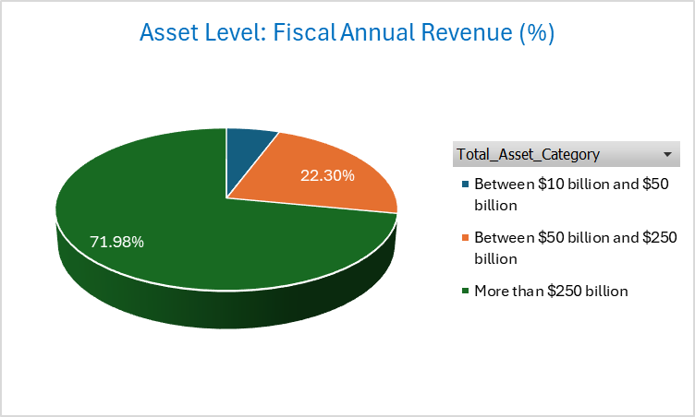
Summary Statistics: Asset Level Annual Income & Quarterly Revenue

Slide 13
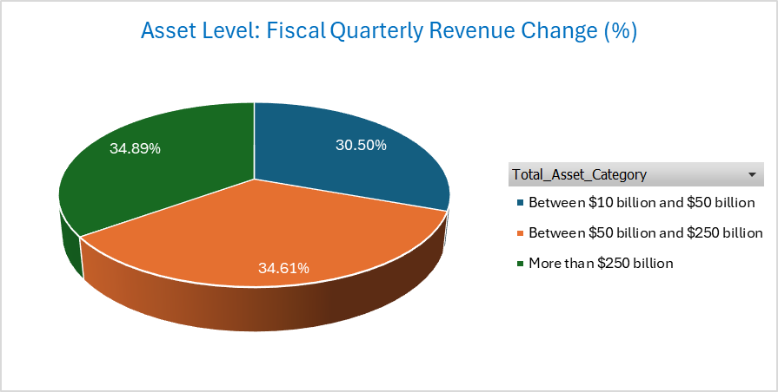
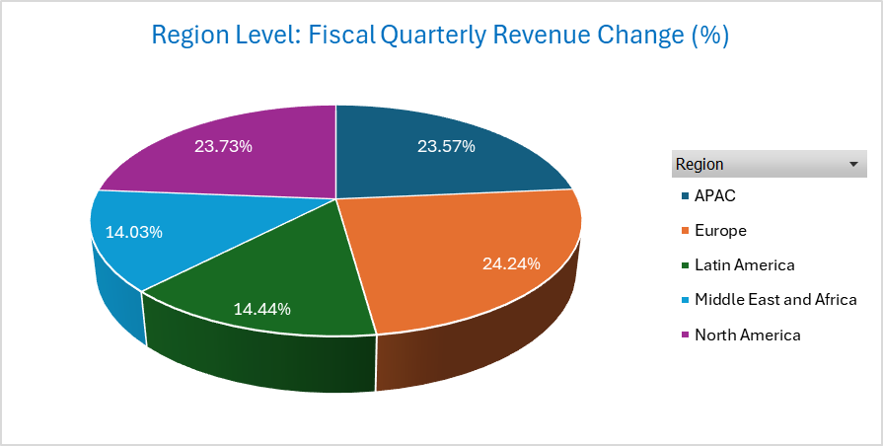
Summary Statistics: Region Wise Annual Income & Quarterly Change

Slide 14
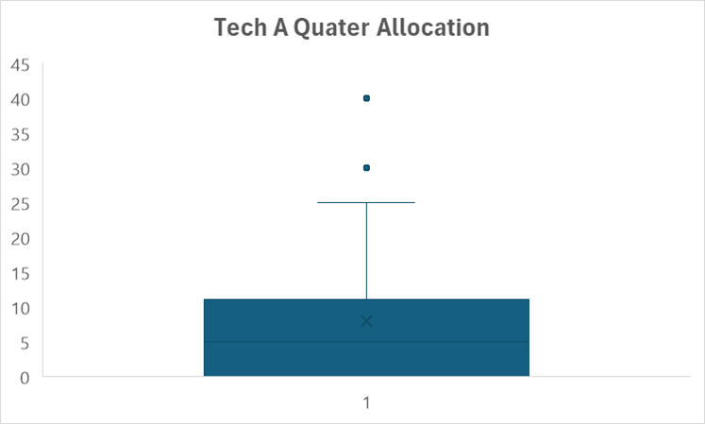
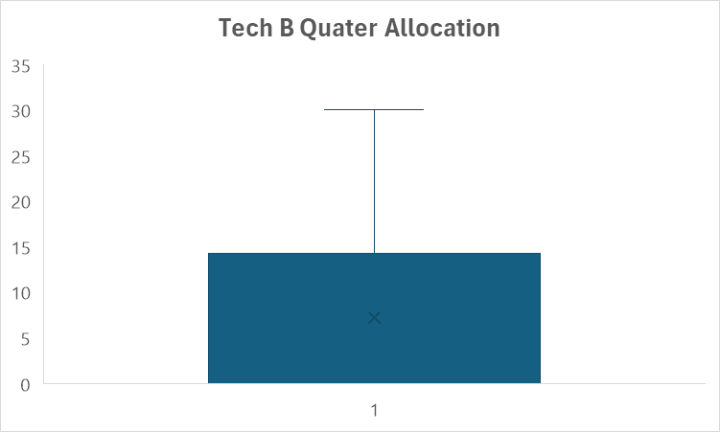
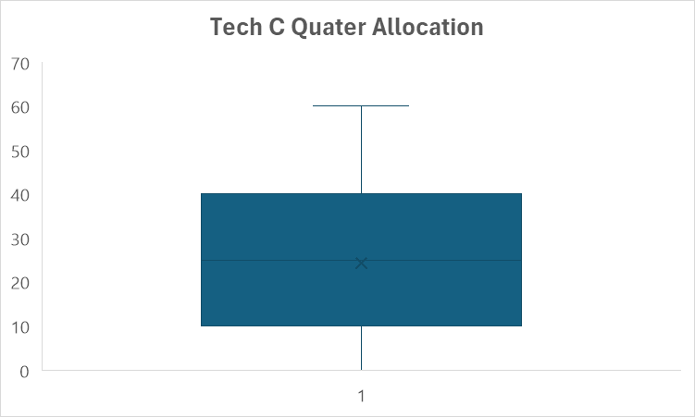
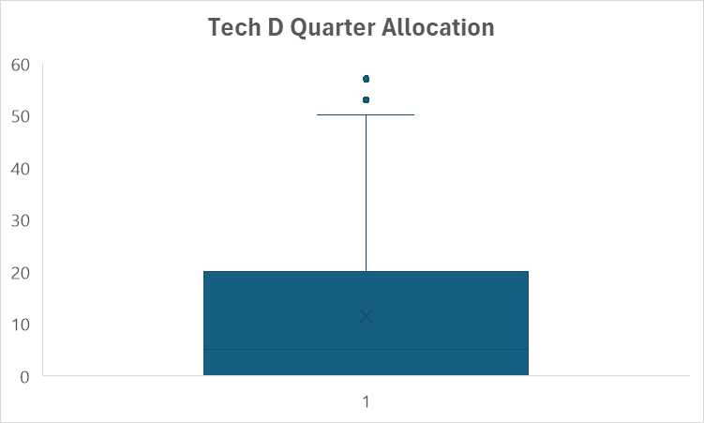
Outlier Summary - Tech Allocation

Slide 15
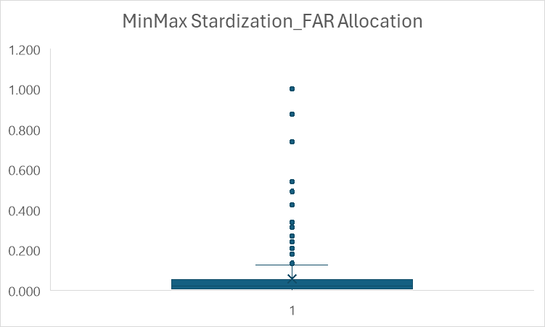
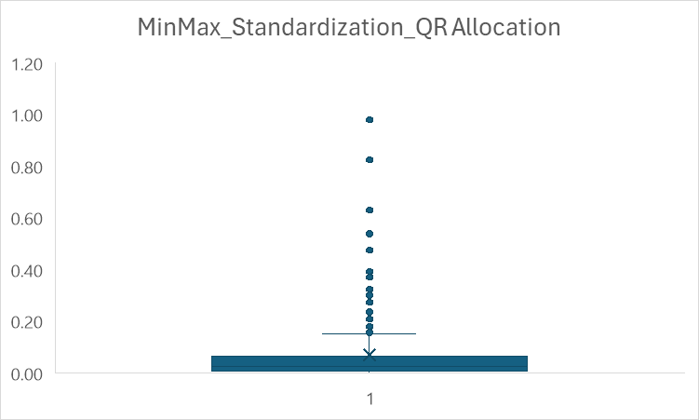
Allocation Metrics: MinMax Standardization

Slide 16
Insights
From the report Summary we can conclude that regional level Budget allocations are having high variations between the regions and technology allocations are mostly observed lowest allocations.
Regional wise Annual income and Quarterly revenue are similar allocations observed for North America and Middle East Africa, with an average of 12K in Annual income and an average of 2K for quarterly revenue.
Performed Outlier analysis for all Tech A, Tech B, Tech C and Tech D but Tech A and Tech D are having Outliers.
Due to high variation among Income and revenue metrics performed MinMax Scalar Standardization.

